Slide 1
NETWORK INTRUSION DETECTION SYSTEM FOR IOT Asymmetric Parallel Auto-Encoder {APAE}
Under the guidance of: Presenting by:
Dr . Jayasudha J. S. MALLARAPU VIJAY
Professor & Head PCS052121
Department of Computer Science Department of Computer Science
Central University of Kerala Central University of Kerala

Slide 2
ABSTRACT
In the world of IoT, interconnected devices have brought convenience and efficiency to many applications.
However, this surge in connectivity is also created new avenues for cyber threats.
The APAE model is based on an asymmetric parallel auto-encoder framework, which allows for a lightweight and powerful architecture.
It uses an auto-encoder architecture to detect attacks in IoT networks.
The first encoder captures local features with standard convolutional layers and a positional attention module. The second encoder captures long-range information with dilated convolutional layers and a channel attention module.
The UNSW-NB15 dataset is used to evaluate this model.
The accuracy of this model on training and testing data is 99.89% and 97.90%, respectively.

Slide 3
Introduction
An Intrusion Detection System is a security technology used to monitor network traffic or system activities for signs of malicious activities or unauthorized access.
Effective intrusion detection capabilities require keeping up with evolving IDS due to changing threats, tech advancements, and attack vectors.
The APAE system efficiently detects real-time attacks in complex IoT traffic.
It is able to detect various attacks in IoT networks.

Slide 4
Literature Survey
S.NO | Paper name / Application | Methodology | Reference
01 | Wireless Network Intrusion Detection Based on Improved Convolutional Neural Network | wireless network intrusion detection method based on ICNN. The test results on the KDDTest show that compared with the traditional models, the detection accuracy is 8.82%. | HONGYU YANG et.al.
02 | Conditional Variational Autoencoder for Prediction and Feature Recovery Applied to Intrusion Detection in IoT | It is an Unsupervised network intrusion detection method ID-CVAE. It is able to recover missing features and The accuracy of ID-CVAE on the NSL-KDD dataset reaches 80.10%. | Manuel Lopez-Martinet et.al.
03 | Evolutionary Optimization with Variational Auto encoder based Denial of Service Attack Detection and Classification in Wireless Sensor Networks | The purpose of the AOVAE-ADC technique lies in the identification and classification of attacks that exist in the WSN. To attain this, the presented AOVAE-ADC technique normalizes the WSN data using the min-max data standardization technique. | C. Murgesh et.al.

Slide 5
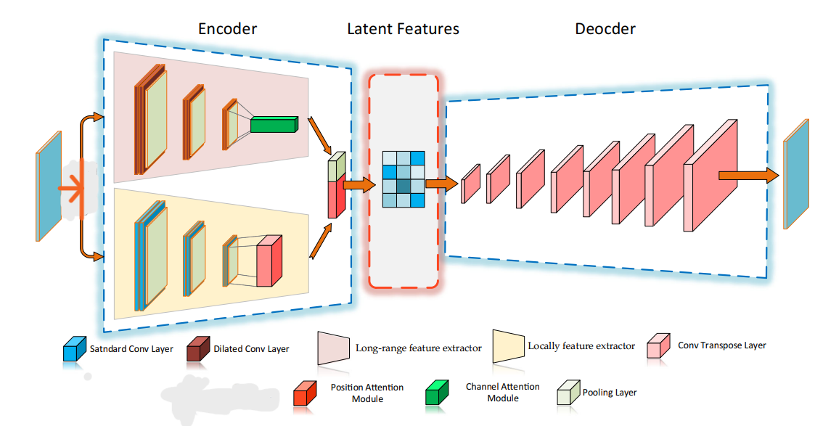
Methodology

Slide 6
Preprocessing
Label encoding: Convert categorical data into numerical format. In label encoding, each unique category or class is assigned a unique integer value.
Resampling: Oversampling artificially increases the number of minority class instances and decreases the majority class instances by generating new or replicating existing samples.
Normalization: In the normalization process, the standard scaler is used to transform features to have a mean of zero and variance of one.

Slide 7
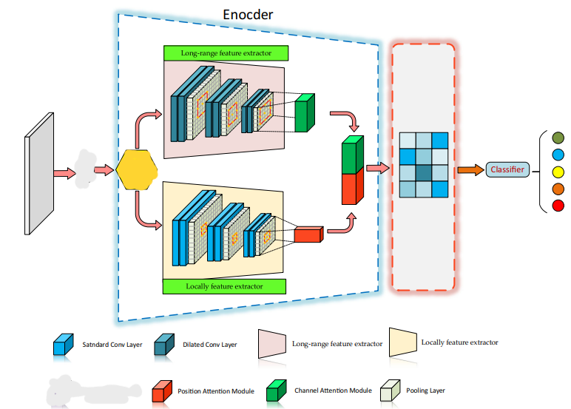
Proposed Methodology

Slide 8
Dataset description
UNSW-NB15 dataset consists of 1,75,341 records in the training set and 82,332 records in the testing set.
It consists of 43 features, of these features (2 binary, 3 categorical, 37 numerical input attributes, and 1 class attribute).
This dataset contains nine types of attacks (Generic, Exploits, Fuzzers, DoS, Reconnaissance, Analysis, Backdoor, Shellcode, Worms) and Normal class.

Slide 9
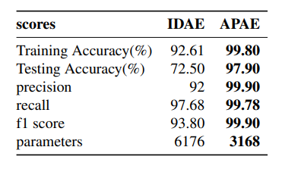
Result Analysis
The model has only 3168 parameters where as IDAE has 6176 parameters which shows about 50 and 55 percent decrease in network complexity compared to IDAE respectively.

Slide 10
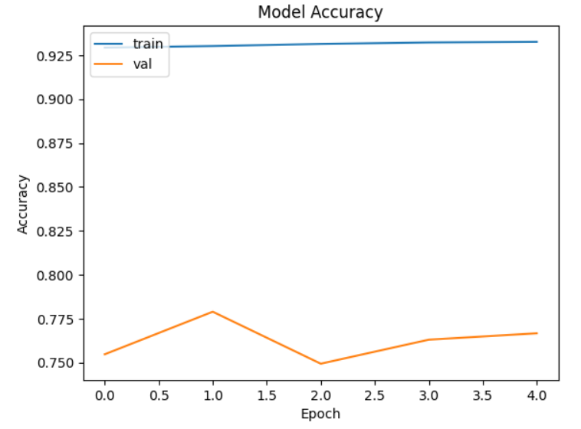
MODEL ACCURACY

Slide 11
conclusion
The feature vector is processed using dilated and standard convolutional filters to extract both local and long-range information.
The architecture also uses a positional self-attention and a channel self-attention module to enhance the local and long-range features.
The APAE can accurately detect attacks using a small and lightweight deep neural network that separates features. It is suitable for IoT devices with low processing capabilities, even in minority classes.
APAE is evaluated using the UNSW-NB15 dataset. Efficiency is crucial in the IoT world where devices have limited processing capabilities.

Slide 12
reference
C. Murugesh and S. Murugan, "Evolutionary Optimization with Variational Auto-encoder based Denial of Service Attack Detection and Classification in Wireless Sensor Networks," 2022 International Conference on Augmented Intelligence and Sustainable Systems (ICAISS), Trichy, India, 2022, pp. 994-1000, doi: 10.1109/ICAISS55157.2022.10010920.
Y. Yang, K. Zheng, B. Wu, Y. Yang and X. Wang, "Network Intrusion Detection Based on Supervised Adversarial Variational Auto-Encoder With Regularization," in IEEE Access, vol. 8, pp. 42169-42184, 2020, doi: 10.1109/ACCESS.2020.2977007.
Popoola SI, Adebisi B, Hammoudeh M, Gui G, Gacanin H (2020) Hybrid Deep Learning for Botnet Attack Detection in the Internet of Things Networks. IEEE Int Things J 8:4944.

Slide 13
Thank you

